Slide 1

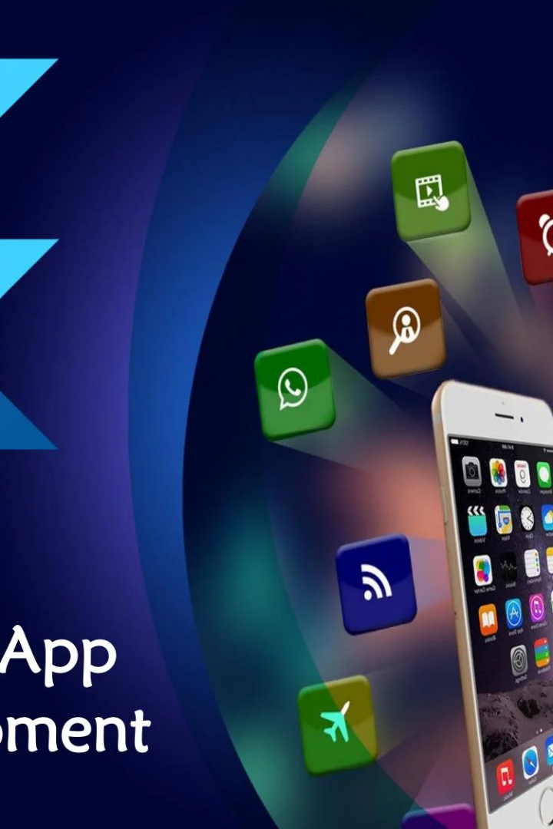


Flutter: A Revolutionary Mobile App Development Framework
Flutter is an open-source mobile app development framework that allows for the creation of beautiful, performant apps for both iOS and Android platforms. Let's dive into some of its key features and benefits!
by Ankit varshney

Slide 2
What is Flutter?
Cross-platform capability
Expressive and flexible designs
Flutter allows developers to create apps that run seamlessly on both iOS and Android platforms without compromising on performance.
The rich set of pre-built widgets and tools allows for the creation of visually stunning and highly customized designs.
Faster development
Strong community support
Flutter's hot reload feature allows for faster development cycles, reducing the time and resources required for development.
Flutter has a rapidly growing community of developers, offering a wealth of resources, knowledge, and support.

Slide 3
Key Features of Flutter
1
Widgets
Flutter offers a rich library of customizable and reusable widgets for building beautiful and intuitive user interfaces.
2
Animations
Flutter's built-in animation library enables easy creation of complex and engaging animations and transitions.
3
Services integration
Integrated APIs and plugins enable seamless integration with popular services such as Google Maps, Firebase, and more.
4
Testing tools
Flutter provides a suite of testing tools, including unit, widget, and integration tests, to ensure your app is running seamlessly on multiple platforms.

Slide 4
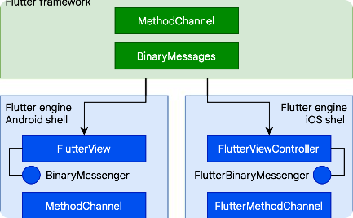
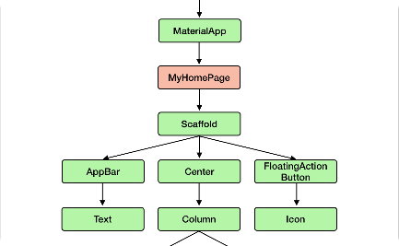
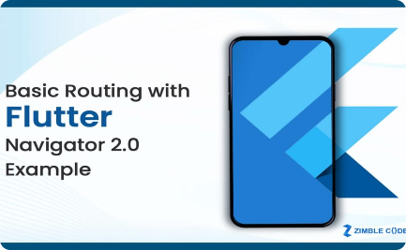
Flutter Architecture
Flutter's Layered Architecture
The Flutter Widget Tree
Flutter Routing
Widgets in Flutter are arranged in a hierarchical structure called a widget tree. Each widget represents a unique user interface element, and the tree represents the entire user interface of the app.
Flutter's routing system allows for easy navigation between screens and management of app state.
Flutter follows a layered architecture, consisting of a widget layer for creating the UI, a rendering layer for rendering the output, and an engine layer for managing low-level operations.

Slide 5
Creating UI with Flutter
1
Creating Simple UI Elements
2
Customizing Widgets
3
Layout Design
Flutter provides several layout widgets to help arrange UI elements in a variety of patterns and designs
Flutter offers a rich set of pre-built widgets for creating basic UI elements such as text, images, buttons, and more.
Flutter's widgets are highly customizable, allowing for easy customization of color, size, shape, and more.

Slide 6
Flutter Widgets
1
Material Widgets
Material widgets follow Google's design guidelines, providing beautiful and dynamic visual elements.
Cupertino Widgets
2
Cupertino widgets mimic the design and behavior of iOS apps, providing a familiar user experience for iOS users.
3
Custom Widgets
Flutter allows developers to create and customize their own widgets, enabling unique and tailored design solutions.

Slide 7

Hot Reload in Flutter
Efficient App Development
With Flutter's hot reload feature, developers can see changes to their code in real-time without having to wait for builds or restarts.
Better Collaboration
Hot reload reduces the time and effort required for testing and debugging, making it easier for developers to collaborate on app development.
Faster Iterations
Hot reload allows for rapid iterations and experimentation, enabling developers to quickly iterate on designs and features.

Slide 8
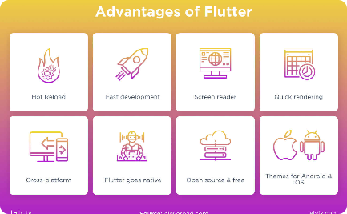

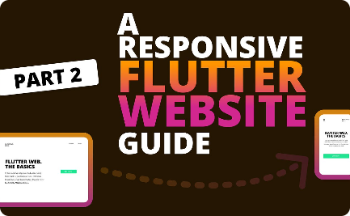
Benefits of Using Flutter
Faster Development Time
Better Performance
Strong Community Support
Flutter's unique architecture and reactive programming model enable high-performance apps on both iOS and Android platforms.
Flutter's rich set of pre-built widgets and tools enable faster and more efficient app development cycles.
Flutter has a rapidly growing community of developers and users, providing a wealth of resources, knowledge, and support for app development.

